Slide 1
Chapter 5 - Network firewall policies configuration

Slide 2
Firewall rules and configurations
You create firewall rules to allow a computer to send traffic to, or receive traffic from, programs, system services, computers, or users.
Firewall rules can be created to:
Allow the connection.
Allow a connection only if it is secured through the use of Internet Protocol security (IPsec).
Block the connection.
Notes:
Denial of service
An attacker sends specially crafted packets to a Web server, causing it to crash.
Malicious code
A worm uses open file shares to quickly infect several hundred workstations within an organization
An organization receives a warning from an antivirus vendor that a new virus is spreading rapidly via e-mail throughout the Internet, the organization expects that the new virus will infect some of its hosts within the next three hours

Slide 3
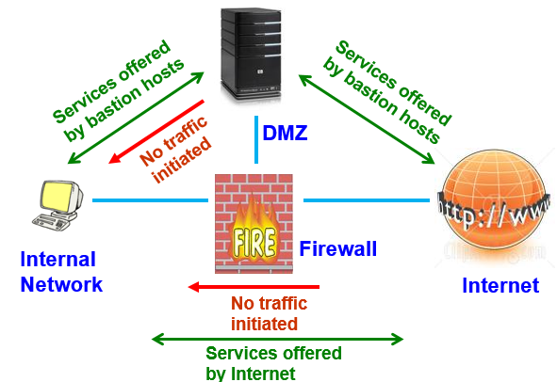
Firewall rules and configurations
Notes:
Denial of service
An attacker sends specially crafted packets to a Web server, causing it to crash.
Malicious code
A worm uses open file shares to quickly infect several hundred workstations within an organization
An organization receives a warning from an antivirus vendor that a new virus is spreading rapidly via e-mail throughout the Internet, the organization expects that the new virus will infect some of its hosts within the next three hours

Slide 4
Firewall rules and configurations
Rule
Direction
Source Address
Destination
Address
Protocol
Source Port
Destination
Port
Action
1
Out
Internal
Any
TCP
>1023
23
Permit
2
In
Any
Internal
TCP
23
>1023
Permit
3
Any
Any
Any
Any
Any
Any
Deny
Filtering rules are applied to the packet in order. The first matching condition is the rule applied the packet.
For safety, filtering rules should have a deny all condition at the end of the rules.
Notes:
Denial of service
An attacker sends specially crafted packets to a Web server, causing it to crash.
Malicious code
A worm uses open file shares to quickly infect several hundred workstations within an organization
An organization receives a warning from an antivirus vendor that a new virus is spreading rapidly via e-mail throughout the Internet, the organization expects that the new virus will infect some of its hosts within the next three hours

Slide 5
Firewall rules and configurations
Rule
Direction
Source Address
Destination
Address
Protocol
Source Port
Destination
Port
Action
1
Out
Internal
Any
TCP
>1023
23
Permit
2
In
Any
Internal
TCP
23
>1023
Permit
3
Any
Any
Any
Any
Any
Any
Deny
Eg: Filtering telnet
Rule 1 - allows outgoing Telnet (port 23)
Rule 2 - allows response from Telnet server
Rule 3 - is the default deny rule
Notes:
Denial of service
An attacker sends specially crafted packets to a Web server, causing it to crash.
Malicious code
A worm uses open file shares to quickly infect several hundred workstations within an organization
An organization receives a warning from an antivirus vendor that a new virus is spreading rapidly via e-mail throughout the Internet, the organization expects that the new virus will infect some of its hosts within the next three hours

Slide 6
Firewall rules and configurations
Packet Filtering Rules (Two common strategies)
Build rules from most specific to most general. This is to ensure that a general rule does not “override” a more specific but conflicting rule.
Rules should be ordered such that the ones most often used are at top of list. Done for performance reasons.
Notes:
Denial of service
An attacker sends specially crafted packets to a Web server, causing it to crash.
Malicious code
A worm uses open file shares to quickly infect several hundred workstations within an organization
An organization receives a warning from an antivirus vendor that a new virus is spreading rapidly via e-mail throughout the Internet, the organization expects that the new virus will infect some of its hosts within the next three hours

Slide 7
Firewall rules and configurations
Best Practices
Deny all traffic by default, and only enable those services that are needed. (Good or bad?)
Disable or uninstall any unnecessary services and software on the firewall that are not specifically required.
Limit the number of applications that run on the firewall in order to let the firewall do what it's best at doing.
Run the firewall service as a unique user ID instead of administrator or root.
Notes:
While tracking firewall "deny" actions is a good way to identify threats, logging the "allow" actions can give greater insight into malicious traffic that could be both more subtle and more dangerous.

Slide 8
Firewall rules and configurations
Best Practices (contd)
5) Change the default firewall administrator or root password
6) Do not rely on packet filtering alone. Use stateful inspection and application proxies if possible.
7) Ensure that physical access to the firewall is controlled.
8) Regularly monitor firewall logs.
9) Document all firewall rule changes.
Notes:
Denial of service
An attacker sends specially crafted packets to a Web server, causing it to crash.
Malicious code
A worm uses open file shares to quickly infect several hundred workstations within an organization
An organization receives a warning from an antivirus vendor that a new virus is spreading rapidly via e-mail throughout the Internet, the organization expects that the new virus will infect some of its hosts within the next three hours

Slide 9
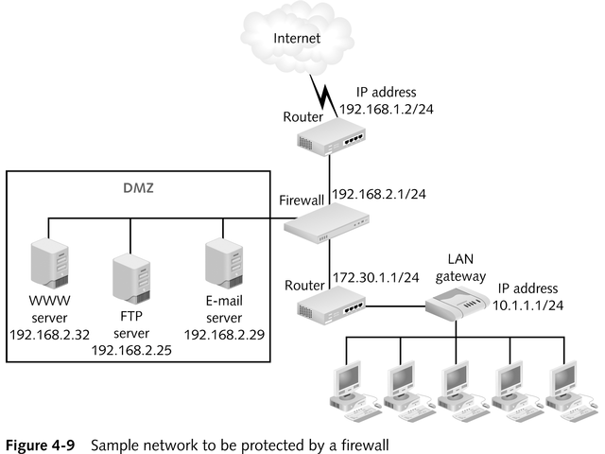
Sample Network to Be Protected by a Firewall
Notes:
9

Slide 10
Rules for ICMP Packets
ICMP lets you test network connectivity and makes you aware of communications problems
Rules are especially important because ICMP packets can be easily forged and used to redirect other communications
Notes:
10

Slide 11
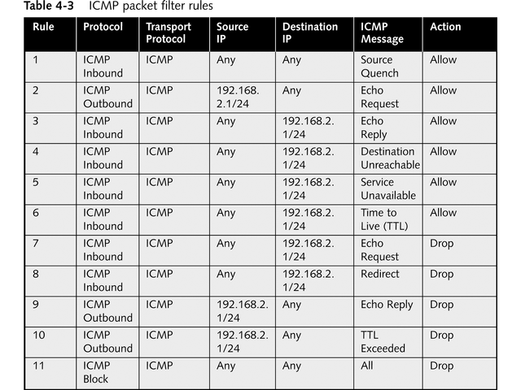
ICMP Packet-Filter Rules
Notes:
11

Slide 12
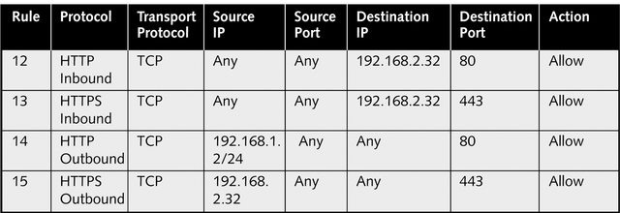
Rules That Enable Web Access
Rules need to cover both standard HTTP traffic on TCP Port 80 as well as Secure HTTP (HTTPS) traffic on TCP Port 443
Notes:
12

Slide 13
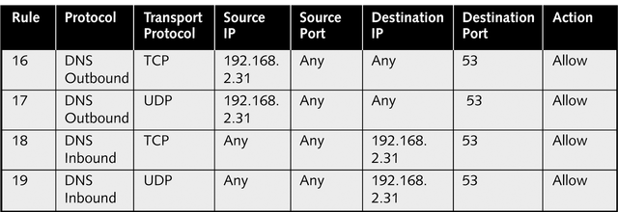
Rules That Enable DNS
Set up rules that enable external clients to access computers in your network using the same TCP and UDP ports
Notes:
13

Slide 14
Rules That Enable FTP
Rules need to support two separate connections
  TCP Port 21 (FTP Control port)
  TCP 20 (FTP Data port)
Notes:
14

Slide 15
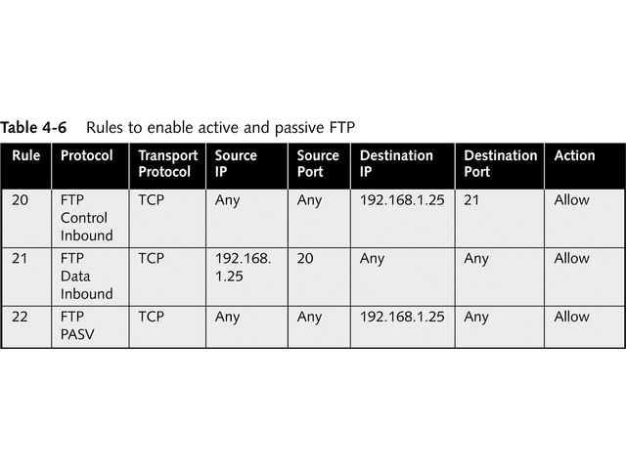
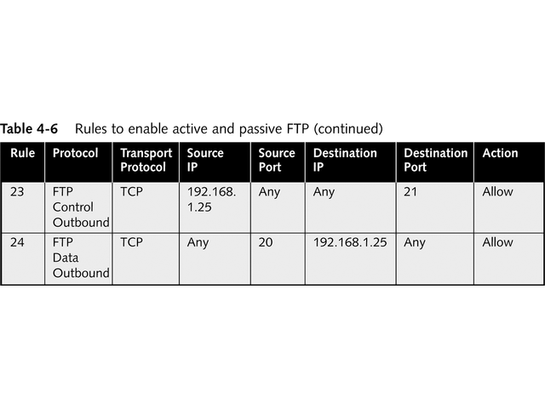
Rules That Enable FTP (continued)
Notes:
15

Slide 16
Rules That Enable E-Mail
Complicated; a variety of protocols might be used
  For inbound mail transport
    Post Office Protocol version 3 (POP3)
    Internet E-mail Access Protocol version 4 (IMAP4)
  For outbound mail transport
    Simple Mail Transfer Protocol (SMTP)
  For looking up e-mail addresses
    Lightweight Directory Access Protocol (LDAP)
  For Web-based mail service
    HyperText Transport Protocol (HTTP)
Notes:
16

Slide 17
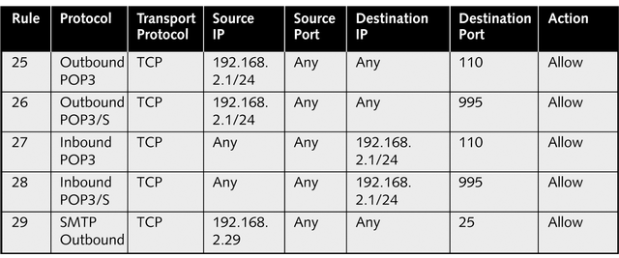
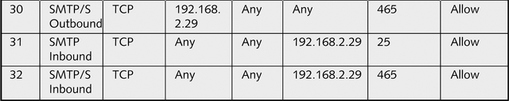
POP3 and SMTP E-Mail Rules
Notes:
17

Slide 18
Cyber Intelligence from firewall logs and rules
An enterprise can often learn more about its network security not from traffic that was denied, but from what was allowed in.
Notes:
Denial of service
An attacker sends specially crafted packets to a Web server, causing it to crash.
Malicious code
A worm uses open file shares to quickly infect several hundred workstations within an organization
An organization receives a warning from an antivirus vendor that a new virus is spreading rapidly via e-mail throughout the Internet, the organization expects that the new virus will infect some of its hosts within the next three hours

Slide 19
Cyber Intelligence from firewall logs and rules
Enabling logging of "allow" actions gives you visibility into all traffic into the environment. Most threats target open ports rather than closed.
Problem: there is a large amount of data that is collected. How to use effectively?
Answer: Use scripts, to parse through the logs and identify suspicious connections and run periodically. Or, use a centralized log management product which offer a searchable interface into the "allow" actions.

Slide 20
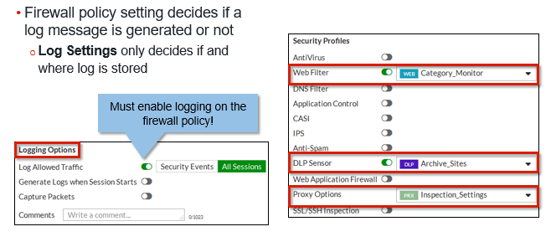
Cyber Intelligence from firewall logs and rules
Enable logging on Firewall policy
Notes:
Once all your logging settings are configured, you can enable logging on your firewall policies. Only when enabled on a firewall policy can a log message generate (based on configured log settings).
Generally, if you configure your FortiGate to inspect traffic, you should also enable logging for that security feature to help you track and debug your traffic flow. Except for violations that you consider to be low in severity – web filtering, for example – you’ll want to know if your FortiGate is blocking attacks. Most attacks don’t succeed in a security breach on the first try. A proactive approach, when you notice a persistent attacker whose methods seem to be evolving, can avoid a security breach. To get early warnings like this, enable logging for your security profiles.
To enable logging on security profiles, edit your firewall policy, enable the security profile, and select your configured security profile from the associated drop-down list. Remember that you will not get logs of any kind if Log Allowed Traffic isn’t enabled in the Logging Options section.

Slide 21
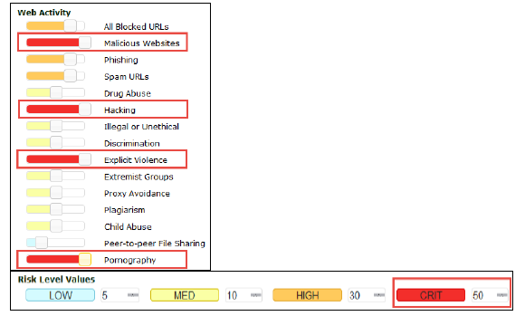
Cyber Intelligence from firewall logs and rules
Enable logging on Firewall policy

Slide 22
Cyber Intelligence from firewall logs and rules
To detect Advanced persistent threats
Senario:
Attacker has gained access to the environment through targeted techniques like spear phishing (not a regular, network-based vector) and is using connections initiated within the network to steal sensitive information, makes it critical to capture these allowed connections.
These connections would generally not be captured when log fidelity is set to track only "deny" actions.
Notes:
These connections would generally not be captured when log fidelity is set to track only "deny" actions.

Slide 23
Cyber Intelligence from firewall logs and rules
Using ‘Deny’ strategically.
Egress filtering involves the use of outbound access control lists, which permit only certain types of traffic to pass through.
Eg: a basic egress filter to allow Web traffic (HTTP/HTTPS) outbound from user workstations. Any outbound connections that are not Web traffic would trigger a "deny" alert.
Eg: Traffic with destination ports 6660/tcp to 6669/tcp could be indicative of IRC traffic and would be logged. This traffic could be indicative of a potential command-and-control channel to a bot herder.
Notes:
Your firewall logs can be a great source of information on what's actually leaving, or trying to leave, your network.

Slide 24
Cyber Intelligence from firewall logs and rules
Blacklists
Used to validate the reputation of the source address against external reputation registries like those listed below:
http://safeweb.norton.com/
http://www.phishtank.com/
http://www.siteadvisor.com/
http://www.trustedsource.org/
http://urlblacklist.com/
http://www.mywot.com/

Slide 25
Cyber Intelligence from firewall logs and rules
Blacklists features:
- Considerably larger than most unmaintained blacklists
- Human verified user submissions
A maintained 'remove' list which avoids common accidentally listed sites such as msn.com
A maintained 'add' list which ensures common 'bad' sites are always included
May also contains many other categories that can be used as white or grey lists
Paid or free

